Slide 1

TikTok 101

Slide 2

WHAT IS TIKTOK? (Part 1)
  A Social Media app that allows users to post videos ranging from a second to 3 minute long.
  The most downloaded apps in the World and United States since 2018.
  Similar to other social media platforms users create a profile in order to post user generated content

Slide 3
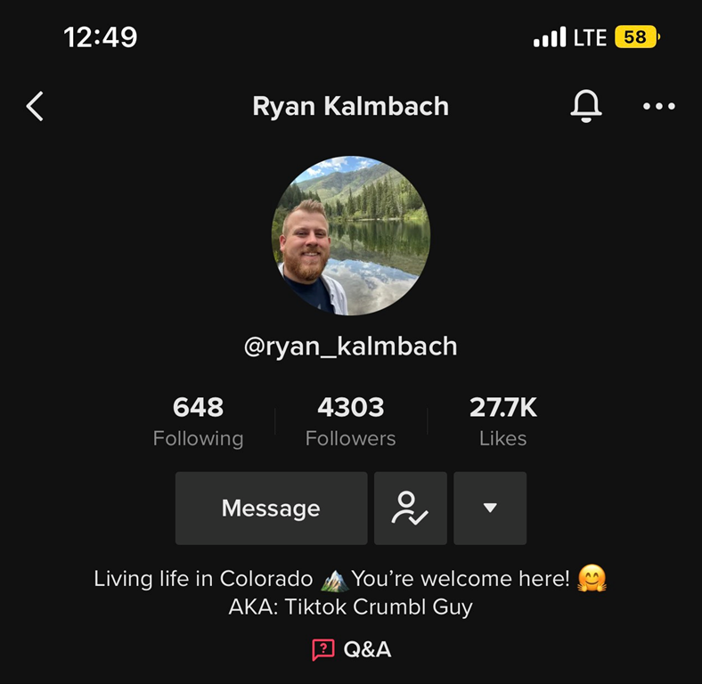
Tik Tok Account Profile
  Each TikTok account has the following metrics
  Following- This is the number of people/accounts on TikTok that the account owner follows
  Followers- This is the number of people/accounts on TikTok that follow the owner of the account
  Likes- Cumulative number of all Likes received on the accounts uploaded content

Slide 4
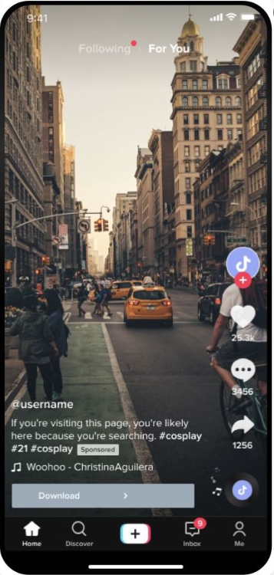
TikTok Homepage- FYP
  For You Page (FYP)- main page users will see when opening TikTok
  Showcases videos based on the individuals TikTok account interests.
  Paid Media from business and influencers will run on the FYP

Slide 5
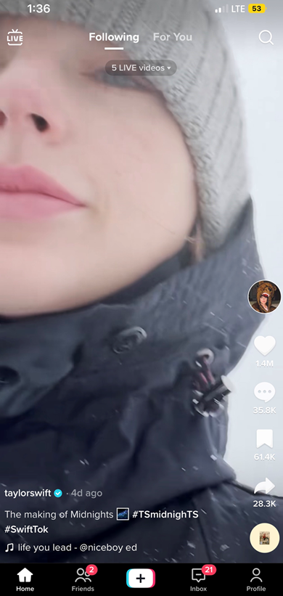
Additional Pages on TikTok
  Friends Page- showcases content shown to a user who are friends with the user and who are their followers
    Ads (Paid Media) are not served on this page.
  Following Page- Showcases content created by followers and Friends (those who follow each other)
    Paid Media ads are no served on this page

Slide 6

TikTok 102

Slide 7

THE FORMATION- Pre-Sales Checklist
  Digital and Local sales review following prior to proposing
    Category lists- Is the client on the prohibited category list?
      If answer is yes, then pivot to other digital offerings
    Client does not have Firewall Restrictions allowing them to access the Portals
    Client collaboration- is the client able and willing to collaborate through the entire process which will be from campaign start to end date
      Must adhere to turnaround times laid out in document and communicated via email
    The above needs to be agreed upon prior to filling out the Campaign Brief.
    Start date of the Campaign needs to be 6-8 weeks out from close of deal

Slide 8

THE BEGINNING- Post Sale
  Internal:
  Digital Ad Ops receives confirmation of WON from CM team
  Digital Ad Ops sends welcome email to Digital AD with Local Sales cc’ed
  Digital AD works with client to fill out Tik Tok campaign brief and submits completed brief (campaign brief slide 4 for details)
  Vendor (RAD) & NCM
  Campaign Brief kicks off Tik Tok process between NCM and RAD

Slide 9
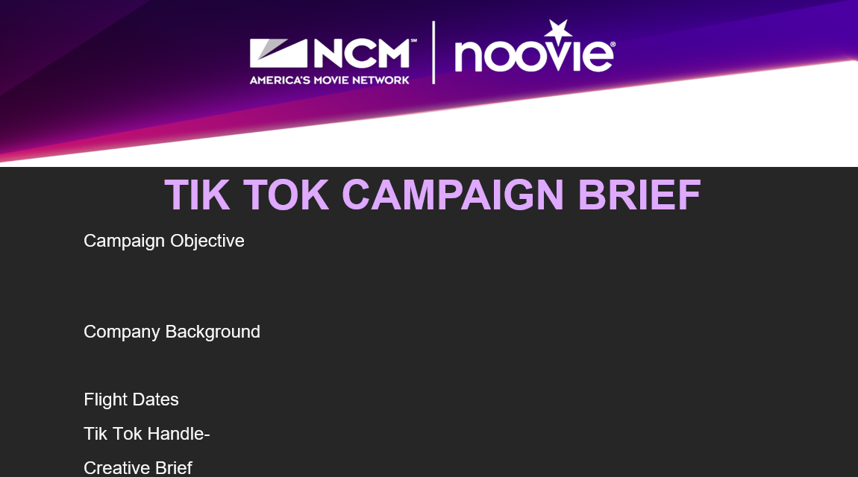
CAMPAIGN BRIEF
  Purpose- Provide comprehensive overview of campaign objective, messaging and ideal influencer
  Must be filled out in its entirety and be as descriptive as possible
  Ideal (Post of influencer) influencers- these should be nano or micro influencers. Describing characteristics that the influencer has is equally important
  List out any requirements that are needed to be in the video including specific actions and wording
  Include hashtags and link to client’s Tik Tok page.
    If client doesn’t have a page please ask them to create
  Ad Ops will review Campaign Brief upon 3 business days of receipt
  Once submitted no changes can be made. Anything provided after the client submits will be considered a revision and additional costs will apply

Slide 10
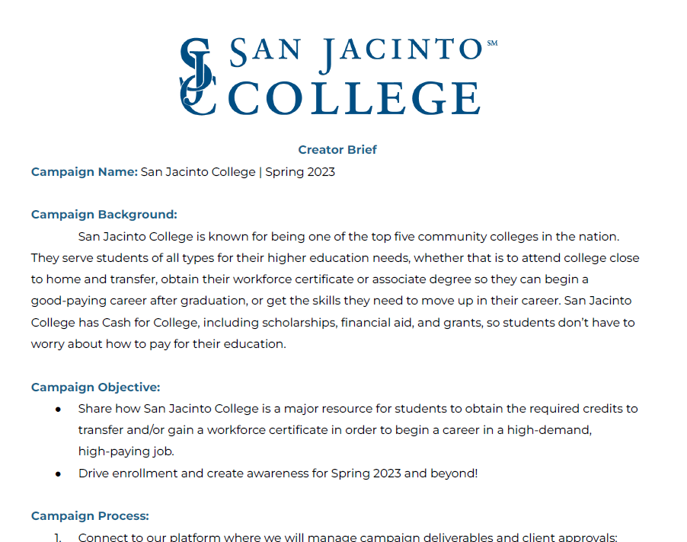
INFLUENCER BRIEF
  Purpose- provides contracted influencers with creative direction. Please note this is not a script for influencers to follow rather a guide for when the influencer is creating the content
    Client will receive influencer brief for review within 3 business days after submitting completed campaign brief.
    Digital AD reviews with Client and Local Sales
    Influencer uses this to create content
    Include required components (Hashtag, Specific Actions or Phrases) for content creation
    Client must approve brief within 3 business days of sent
    Cannot be changed once submitted to Digital Ad Ops Team

Slide 11
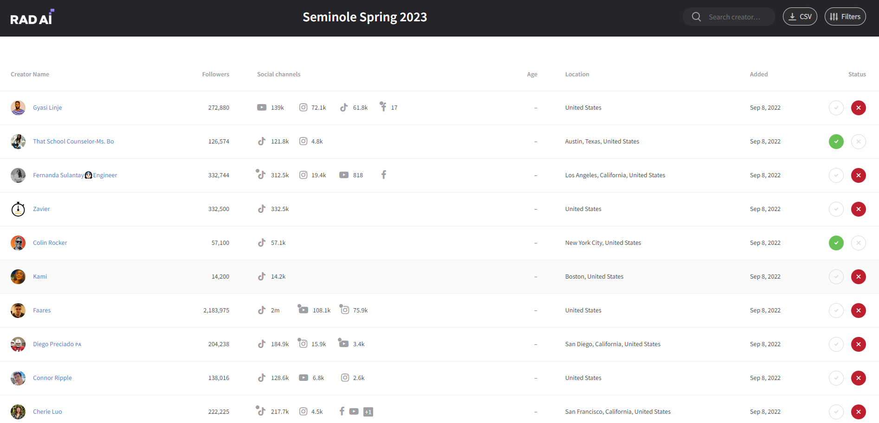
TALENT LIST/TALENT PORTAL
    Purpose: Where the hand selected talent lives and client reviews
    Digital AD to walk through client through how to make selections
    One Talent List will be sent one time at the start of the campaign
      Talent List- 50% or more of talent list must be approved in order to move forward
      Influencer should be reviewed based off content solely.
      Work through with Client the approval/rejection process. All Rejections please provide commentary.
      Approved Influencers are not guaranteed to sign on for the campaign.
    3 Day Business Turn Around Time To Approve/Reject Influencers.
Notes:
PROCESS CHANGE – ONE LIST UP FRONT

Slide 12
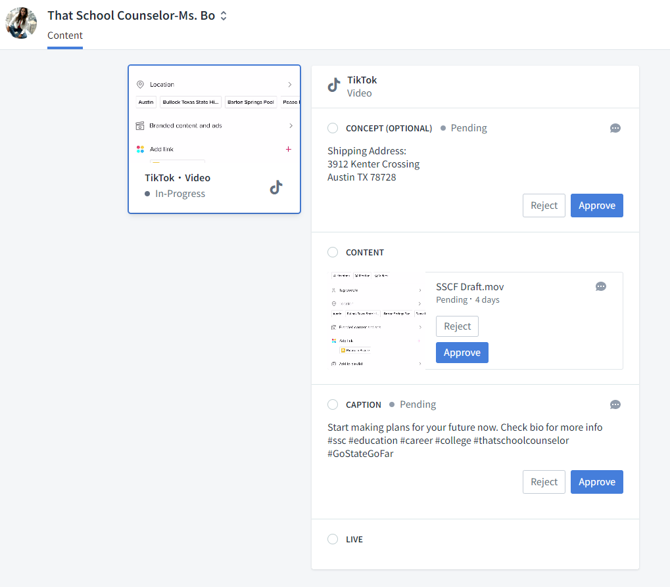
CONTENT CREATIVE PORTAL
Contracted Influencers send in creative - Digital Ad Ops alerts Sales it’s ready for approval/rejection
    2 creative revisions allowed for all assets (Creative, Caption, and Hashtags)
    Goal of first revision is to correct all content/messaging/tone and second is to make minor tweaks.
    All feedback commentary and approval must be submitted through the Portal. Emails not accepted.
    Revisions must align with approved Influencer Brief. Any changes outside of Influencer Brief will require additional spend.
    Client must approve Content and Caption in the Content Creator Portal. This is NCM’s trigger that the content is ready to go live.
    Revisions in this portal are due within 3 Business Days
    Influencers will go live within 3 Business Days of final approval

Slide 13

LIVE
  6-8 Weeks later Campaign is live. Digital Ad Ops confirms launch with Digital Account Director and Local Sales.
    Live link to TikTok Posting is uploaded in email.
      Follow post for engagements, real time information, and commentary.
    Reporting
      Pacing Reports handled by Digital Account Directors
      Questions? Email Digital Ad Ops Team
    All Postings will post within Time Frame between Start and End Date provided by Client

Slide 14
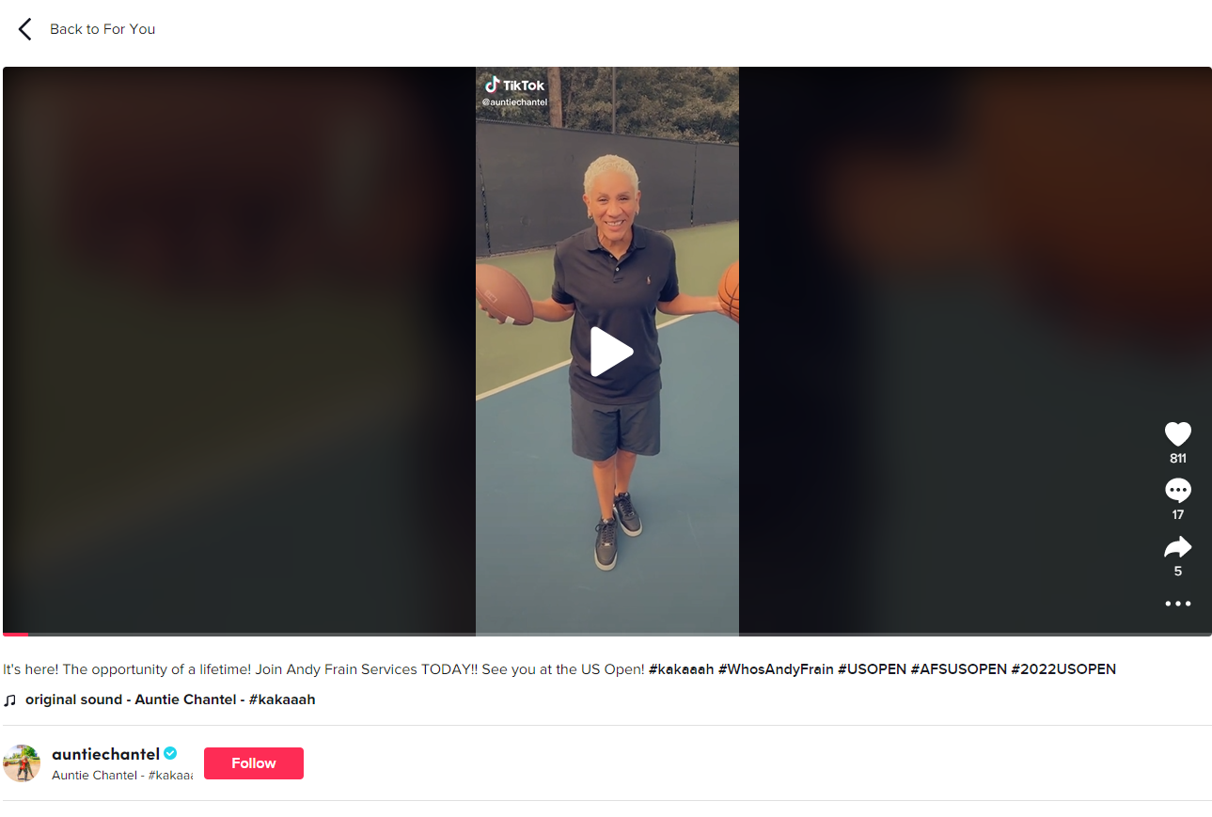
CAMPAIGN END
Campaign Post Report – sent out 10 business days after campaign ends
Case Study – Digital Ad Ops will send to Digital AD to review with local sales and clients.
Influencer’s post will stay live on TikTok for minimum of 90 Days from original post date

Slide 15
PROHIBITED CATEGORIES
  HEALTHCARE
    Vaccines
      COVID Boosters, COVID Vaccines, HPV, Influenza Vaccine, etc.
    Endemic and Epidemic Diseases/Viruses
      HIV, HPV, AIDS
      PrEP, HIV Testing, At Home Testing
    Organ Sharing and/or Donor Programs
    STDs, STIs, Testosterone Supplements, Sex-Related Heath Issues
    Supplements (Vitamins), Weight Loss Pills, Weight Watch Programs
    Pharmaceuticals – including over the counter
  Financial
      Debt Assistance, Loans, Pyramid Schemes, Auctions, NFT, Crypto,
      Lotteries, State Gambling, Online Gambling, Casinos
  Alcoholic
    Subscriptions/Clubs, Making Kits, Sponsored Events, Consumption of Alcohol
  Dating Apps – Dating Services – Sexual Encounters
  Advertising geared toward Children under 18 years of Age
  Fantasy Sports and Sportsbooks
  Shopping Rewards
  Political Advertising Campaigns
  Drug Usage – Legal and Non-Legal Substances, PSA Campaigns
  Invasive Cosmetic Therapy (Lip Injections, Liposuction, etc)
  *ALL CONTENT ASSOCIATED WITH CLIENT CANNOT INCLUDE GRAPHIC VIOLENCE, SEXUAL CONTENT, SUGGESTIVE LANGUAGE, DRUG USAGE, AND/OR SHOCKING CONTENT*
Notes:
Content cannot expose graphic violence, Sexual Content or Suggestive language, Drug Use, or Shocking Content

